Slide 1
Modeling the growht of grape berry
Pre-veraison
Pre-veraison
Post-veraison
Post-veraison
Dry mass
Fresh mass

Slide 2
Water and carbon fluxes

Slide 3
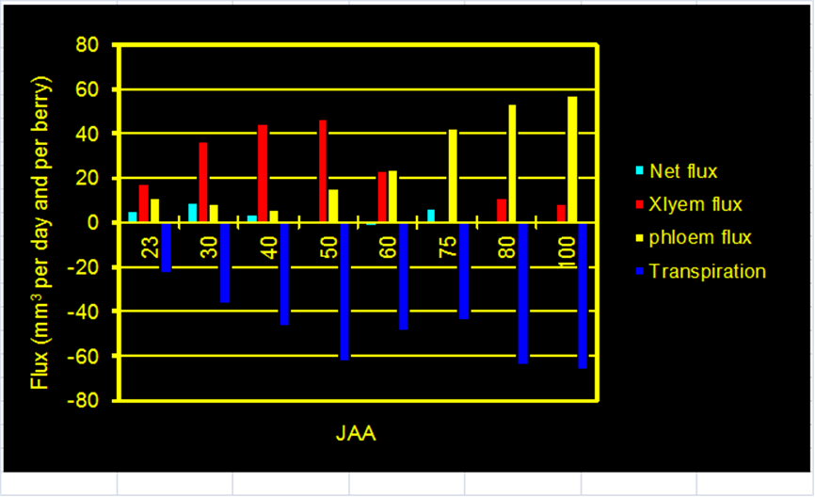
Water flux
Simulated water fluxes during berry growth
Experimental measurements from Ollat et al. 2002

Slide 4
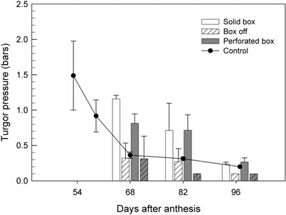
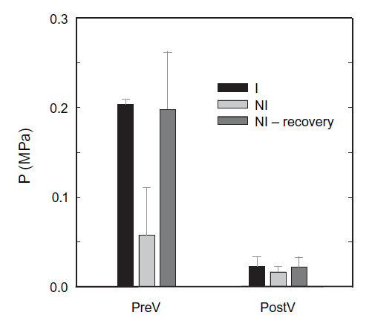
Berry turgor pressure
Pre-veraison
Simulated turgor pressure during berry growth
Post-veraison
Measurements from Matthews et al.,2009
Measurements from Thomas et al.,2006

Slide 5
Parameters variation

